Slide 1
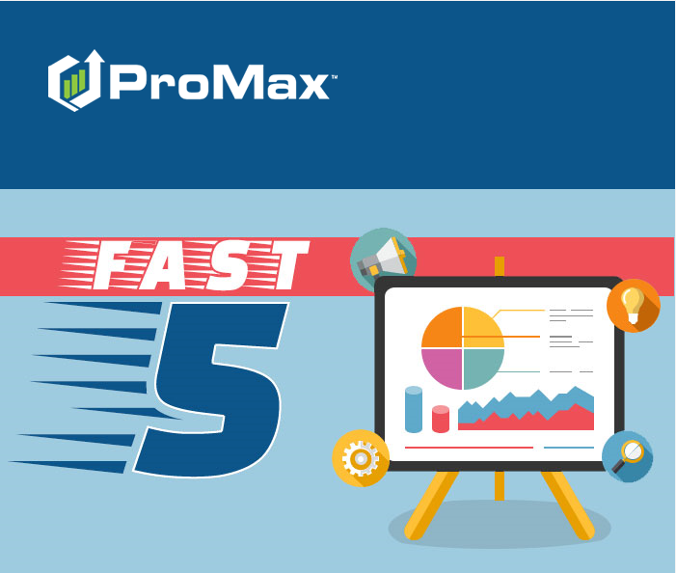
JULY

Slide 2
Agenda
CarFax Integration
Setting Appointments
BDC Settings – Change Log
ProMax BDC
Adding Motorcycles into Inventory

Slide 3
CarFax Integration
If you already have an account with CarFax, we make it easy to integrate that system with ProMax. You can view and run Car Fax reports straight from ProMax.

Slide 4
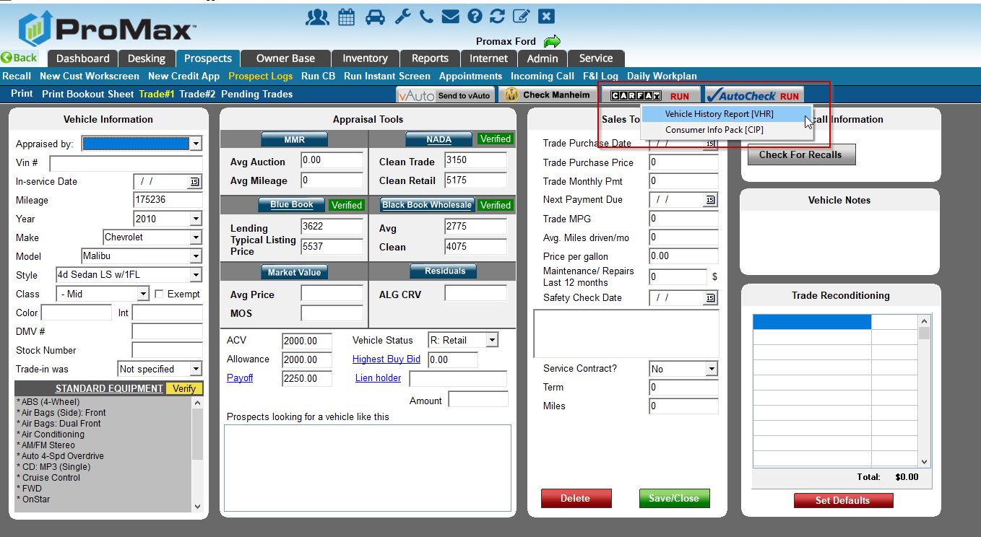
CarFax Integration
If you already have an account with CarFax, it is easy to integrate this in ProMax. We will sync up your account to ProMax for a more seamless experience.
You can run and view CarFaxes from the trade screen or the inventory screen

Slide 5
CarFax Integration
To view a CarFax report that has already been run, the user will just need to have access to view CarFax reports under Admin > User Access.
This is what the reports will look like when being viewed from ProMax.

Slide 6
CarFax Integration
We are currently updating our CarFax Integration. If you are active on this integration, feel free to reach out to me and I can tell you the date that you are moving to the new version. All dealers are being moved over to the new integration this month.
Once you are on the new integration you will have to authenticate in order to run reports. This means that you will be prompted to enter your user specific credentials to confirm you have access in CarFax. This will be required once every 30 days.

Slide 7
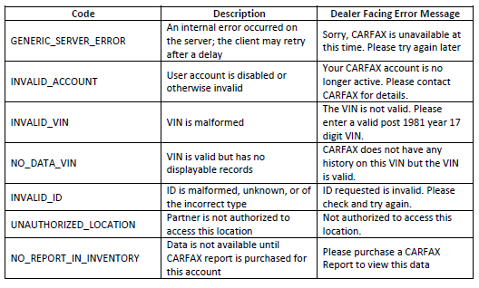
CarFax Integration
From time to time, CarFax may return an error message instead of returning a report. Here are the standard error and what they mean.

Slide 8
Adding Motorcycles into Inventory
We can now do VIN explosions for many motorcycles

Slide 9
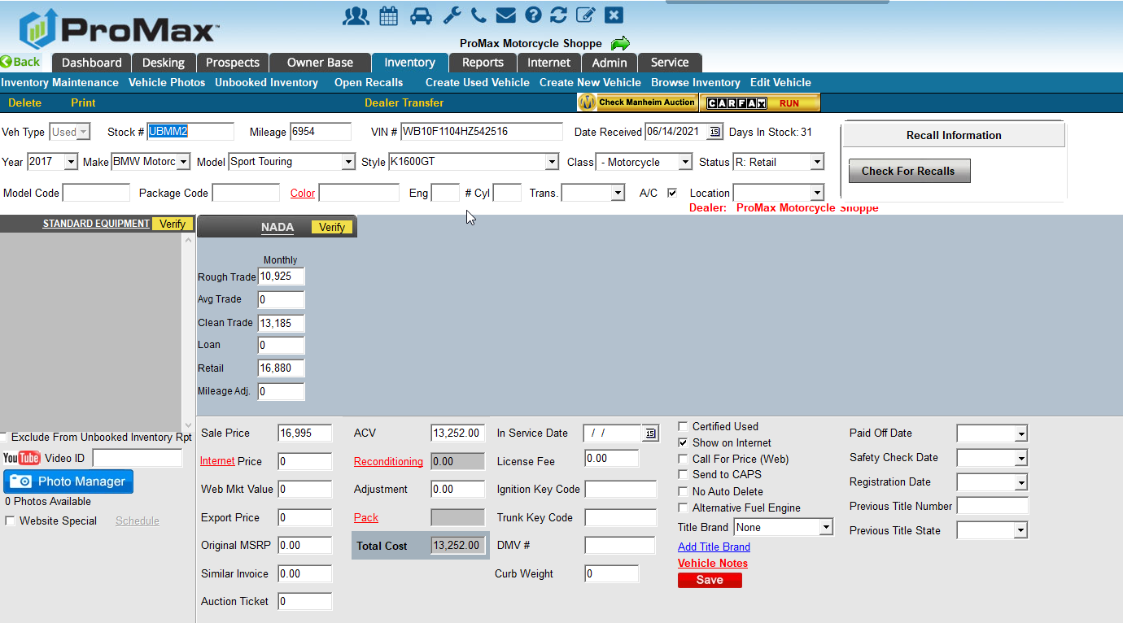
Adding Motorcycles into Inventory
Historically, we have primarily focused on allowing for standard vehicles like cars, trucks, vans, and SUVs into our inventory.
Earlier this month we added the ability for VIN explosions to populate many popular motorcycles. You can also add these in manually without having to choose “other” as the make.

Slide 10
Setting Appointments

Slide 11
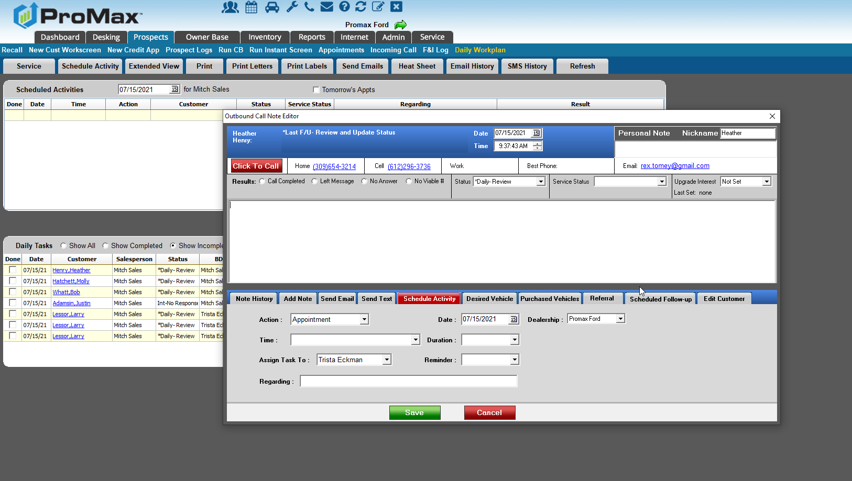
Setting Appointments
If you are someone who is setting appointments a lot, you are likely constantly on the phone. In this case, the easiest way to log all your calls and schedule upcoming appointments is from the schedule activity tab in the reason link through the Daily Work Plan. From here you have access to virtually everything you would need while you are on the phone.

Slide 12
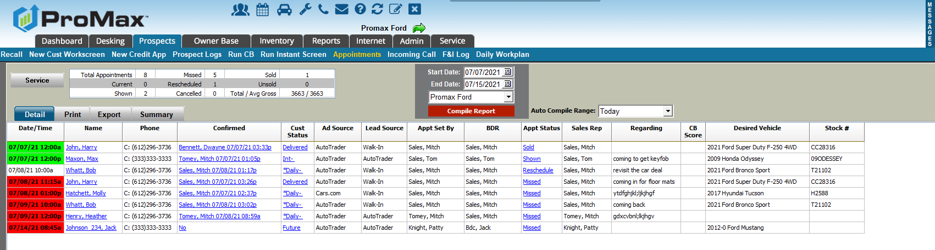
Appointments
You can view your appointments by going to Prospects > Appointments

Slide 13
BDC Settings – Change Log

Slide 14
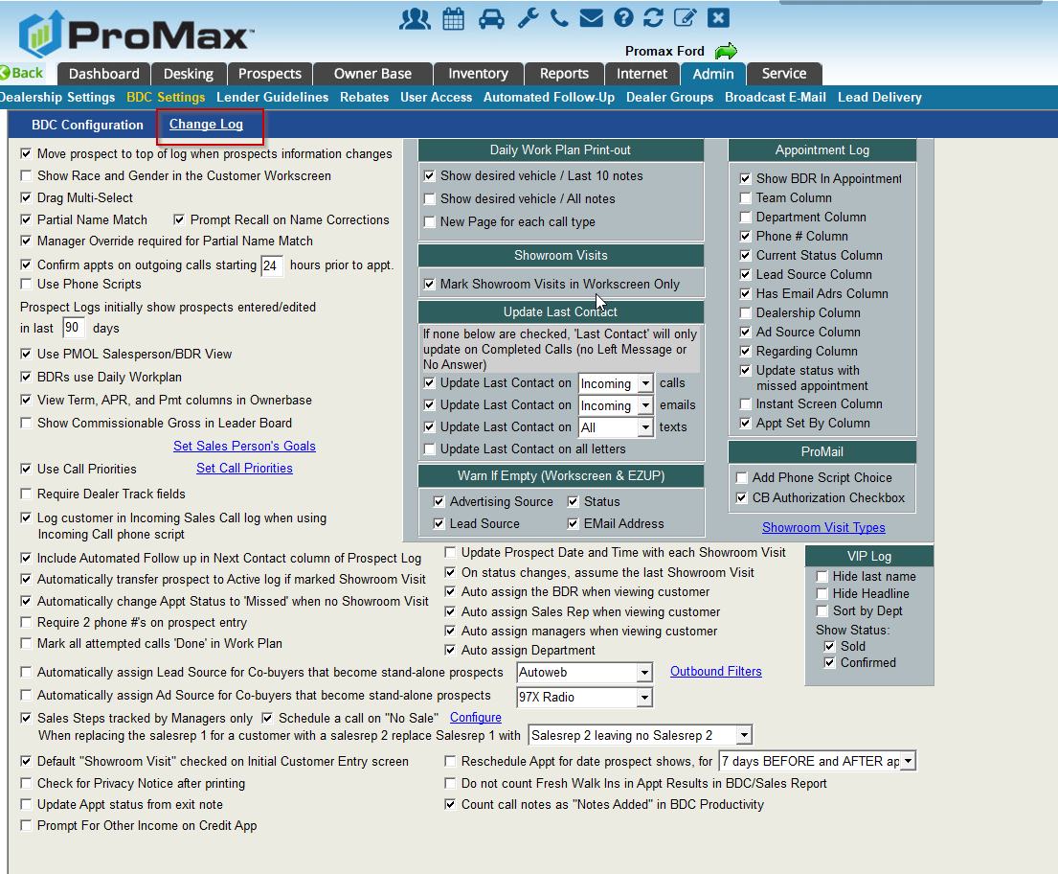
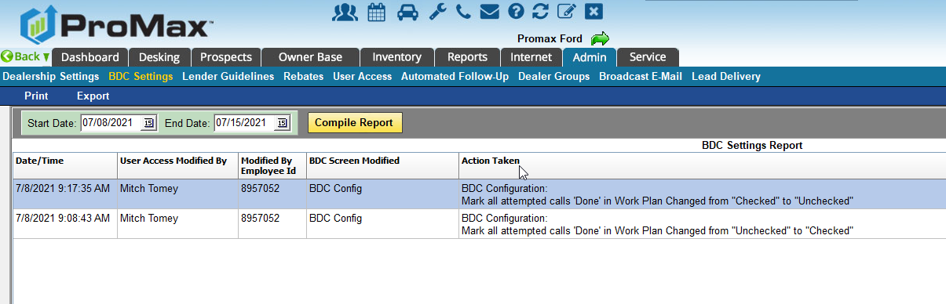
BDC Settings
We have recently added a feature to track changes that were made to the BDC Settings in Admin

Slide 15
ProMax BDC
Put our BDC to work for you. We are flexible with our offerings. We can provide all your BDC needs or compliment your existing team.

Slide 16
Why Use the ProMax BDC?
High Staff Turn Over
  The ProMax BDC is a reliable team of 12 individuals that provide coverage 6 days/week (M-F 7am-8pm and Sat 9am-5pm Central Time)
  No hiring or staff training required – no loss of productivity if someone calls in
  Bilingual staff with average tenure of 3 years
High Volume Leads
  Make sure you are not leaving any opportunities on the table by having all of your leads worked thoroughly.
  The ProMax BDC has a proven, long term follow up cadence to ensure each lead is getting the maximum amount of attempted contacts.
  Dealership can work new leads and we can work the old leads – or any combination you would like.
  We guarantee a minimum of 10 contact attempts (call/text/email) in 14 days for each lead.
High Average Response Times
  A faster response time will result in more contacts, more appointments, and more sales
  We guarantee a 15 minute response time, but our average response time is 7 minutes
  We have an after hours response option available for Franchise dealers
Not Enough Leads
  Let us harvest your unsold customers to rejuvenate interest and increase appointments
  Incorporate our other lead generators and mail options to maximize results
Accountability
  Every contact and contact attempt is recorded in your Promax system.
  The ProMax BDC includes an experienced and dedicated BDC Manager who motivates her team and ensures all benchmarks are met
  The ProMax BDC undergoes continual training to ensure they are always performing at their highest level for you and your customers

Slide 17
Why Use the ProMax BDC?
Cost Effective
  Pricing can be scaled to meet a dealer’s budget
  No set up fees
  No monthly minimums
  Standard rate is $12/lead or $6/unsold database customer or special campaign lead
Customizable
  Full engagement – we handle all leads from start to finish
  Lead Overflow – we handle any leads that produce and inactivity alert
  We just work for you on certain days or time
  We only work specific lead sources
  We only work your past data base, unsold showroom visits, marketing campaigns
No Long-Term Commitments
  90 day initial term and then month to month after that
On average we make contact with 40-60% of leads (variance is due to squeeze page leads), set appointments on 50% of those contacts, and have 50% of those appointments show.
  100 leads ($1,200): 50 contacts, 25 appts, 12 shows = 6 sales ($2,000/copy = $12,000 ) ROI over $10,000!

Slide 18
Questions?
Contact our Dealer Support Line at 844-322-9034
Contact me directly at 563-344-7618 or Trista@ProMaxUnlimited.com
PromaxUnlimited.com
Facebook.com/ProMaxUnlimited
Twitter.com/ProMaxUnlimited
LinkedIn.com/Company/ProMax-Automotive-Software/
DealerUpdates.TypePad.com/Blog/

